Slide 1







Augmented Reality
Presentation
By Kholofelo Motlhaka
01/02/2023

Slide 2


Topics to Cover:
What is AR?
How does AR work
Types of AR
Advantages and Disadvantages of AR
Difference between AR and VR
Conclusion

Slide 3




What is Augmented Reality?
Is an interactive experience that combines the real world with computer-generated content.

Slide 4


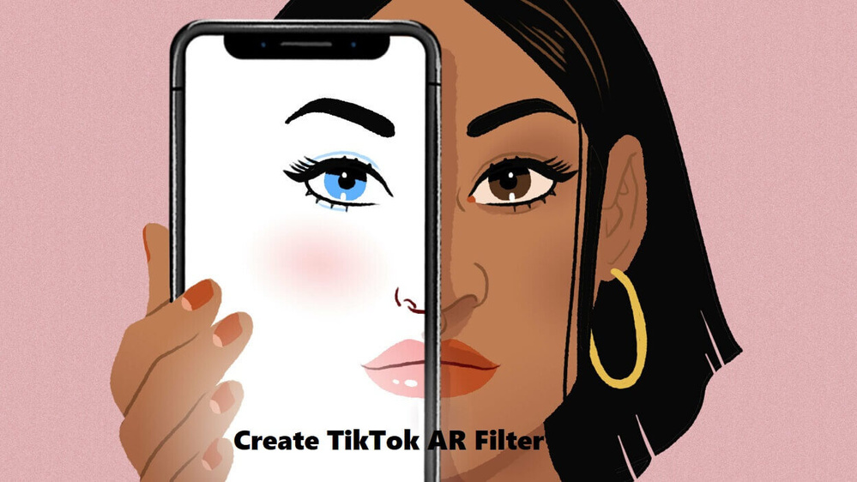
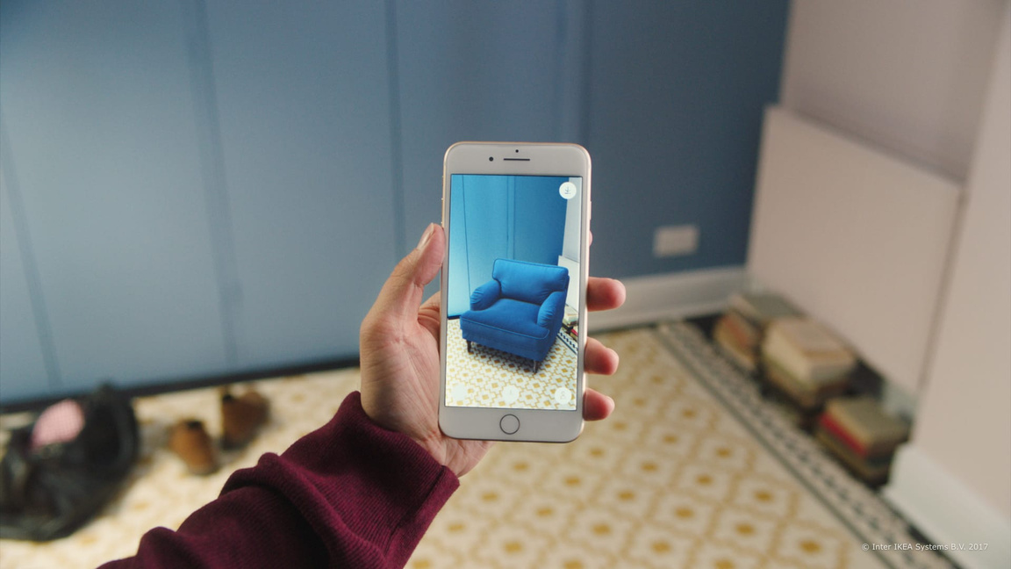

How does AR work?
AR in Healthcare
AR in Entertainment
AR in Retail

Slide 5

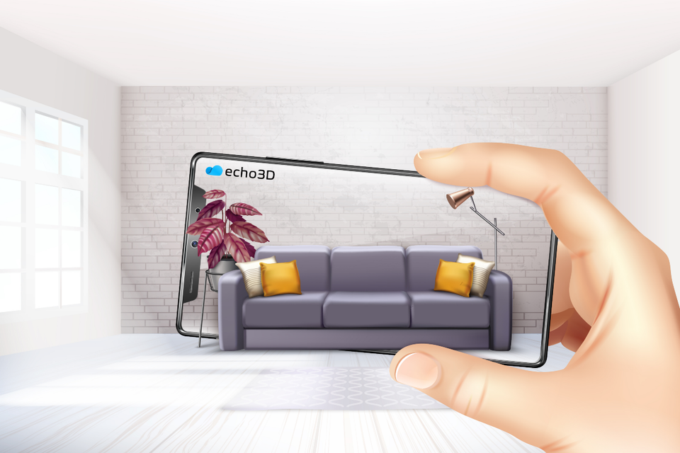

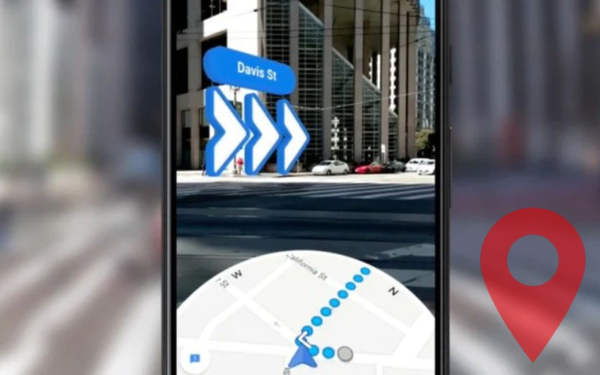
Types of AR
Recognition based AR
Projection based AR
Location based AR

Slide 6
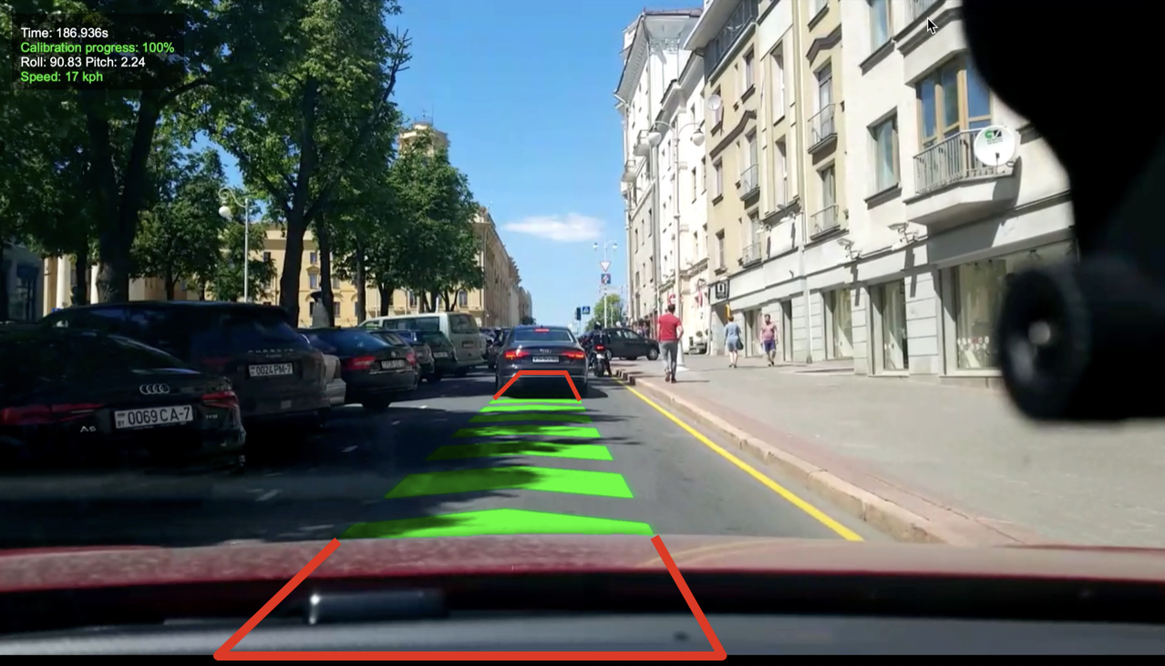

Types of AR continues...
Superimposition based AR
Outlining based
AR

Slide 7

The advantages of AR
Q3
Q4
Q1
Q2
Business Improvement
Unique customer experience
Increase user knowledge and Information
Immersive Video gaming and entertainment

Slide 8
The disadvantages of AR
Q3
Q4
Q1
Q2
Time consuming
Implementation requirements
Functionality Issues
Issues about Privacy
Addictive and laziness

Slide 9

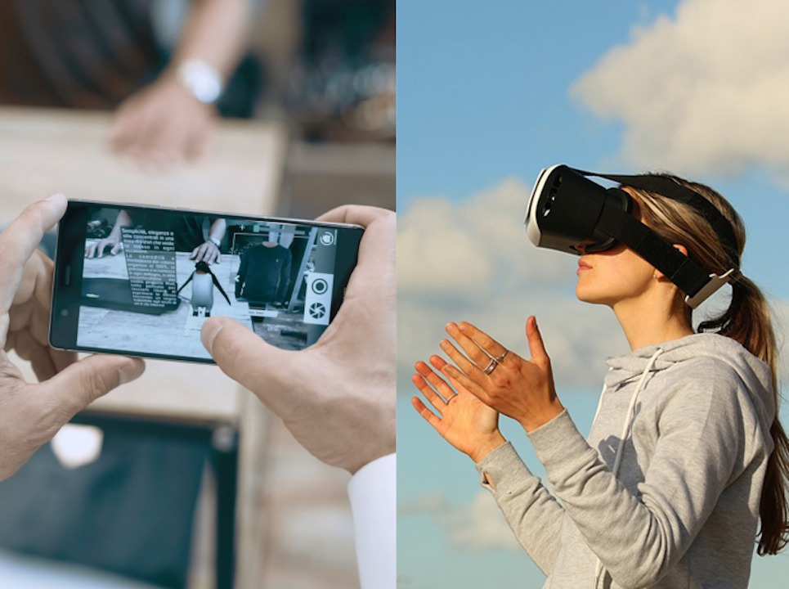

Difference between AR & VR
AR users can control their presence in the real world
AR enhances both the virtual and real world
AR can be accessed with a smartphone
AR uses a real-world setting

Slide 10
Difference between AR & VR
VR users are controlled by the system
VR only enhances a fictional reality
VR requires a headset device
VR is completely virtual

Slide 11
Conclusion:
Since we cannot change reality, let us change the eyes which see reality
Thank You.

